Slide 1
Performance and Complexity
Additional Issues: Paging, Compilers, …
© 2018 L. V. Kale at the University of Illinois Urbana-Champaign

Slide 2
Multiprogramming and Virtual Memory
A computer runs many programs “simultaneously”
It gives each program a time slice of some milliseconds (e.g., 10ms)
How can it keep their memories from mixing up?
Answer: virtual memory
Each program thinks it has the whole processor to itself, and can address memory from 0...X gigabytes
This “virtual” address is mapped to a physical address by the hardware and operating system via “page tables”
Each page has (say) 4 kilobytes of data… It may or may not be in physical memory
If it is not in memory, it is kept on disk (in “swap” space)
The mapping itself is stored in memory!
But most commonly/recently used entries of this map are stored in hardware: TLB or Translation Lookaside Buffer

Slide 3
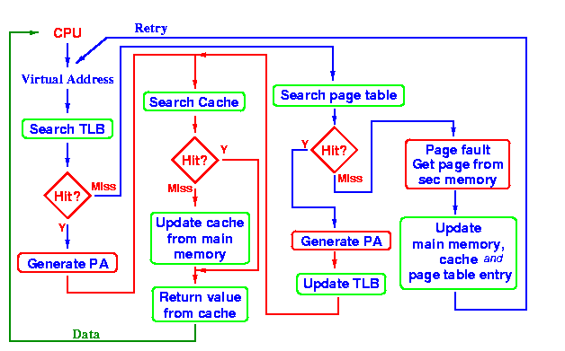
Load Instruction
(Morris, 1998)

Slide 4
What Is a Good Page Size?
In most OSs it is set at 4 KB
That’s fine for multiprogrammed machines
For a dedicated parallel computer?
HugePages option: 2 MB pages, 4 MB pages
On BlueWaters, simply load the 2 MB page module before compilation and execution
Loading a module redirects mallocs to use larger pages

Slide 5
Compilers
Capabilities
Black-box nature
Optimization levels: -O1, -O2, -O3…
Higher level of optimization is better for performance, but occasionally (rarely) may compile wrong!
Lower levels make debugging easier
Flags
More specialized, nuanced, control over what kinds of optimizations the compiler may try
Debug information retained

Slide 6
Bottom Line?
The speed increase has come at the cost of complexity
This leads to high performance variability that programmers have to deal with
It takes a lot to write an efficient program!

Slide 7
References
Morris, J. (1998). Computer Architecture. Retrieved from http://www.cs.auckland.ac.nz/~jmor159/363/html/TLB.html

